Slide 1
Facial Recognition
Barman Rayan

Slide 2
Summary
Introduction (how it works)
My researches
Use of facial recognition against protestors
Use of facial recognition against The Police
Face-mask recognition
Other applications of facial recognition
National facial recognition system
Facial recognition payment technology
Notes:
First of all I’m gonna introduce Facial Reogntion. Then I ’m gonna tell you a little bit of my research on facial recognition. I based my research on two main topics, they are : use of facial recognition during Black Lives Matter mouvement and use of facial recognition in respsonse to covid-19.

Slide 3
Introduction
Big data + artificial inteligence
Identifying or verifying
Identiying: one to many (1:N)
Verifying: one to one (1:1)
Based on 3 phases :
1: face is detected and captured
2: creation of virtual model
3: compared the model to a database
Notes:
Fr is based on big data and articial inteligence. The main goal of fr is to Identifiyng or verifying. 1 step : the face is detected on a photo or video . The second one is the creation of virtual model based on face features like the width of the nose.
And the 3th one is to compare

Slide 4
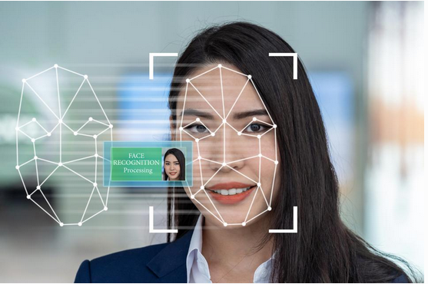
Virtual model

Slide 5
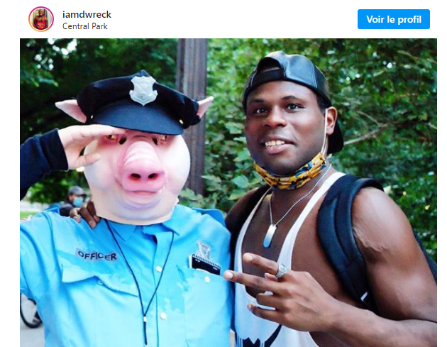
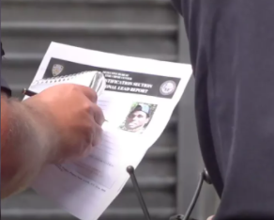
Use of facial recognition against protestors
Notes:
During the summer there were a lot of manifestations against racial injustice. The NYPD used Fr to find somes activists. The NYPD was criticized for using facial recognition because they used social media to find him.

Slide 6
Use of facial recognition against protestors
NYPD and others police departement around the united stated use Clearview AI.
ClearView AI collects data from social media
Used against violent protestors, not peaceful protesors.
The algorithm is not 100% reliable
Notes:
NYPD is not the only one to use … Clearview AI is a firm that specialized in facial R. The differents police departement are confirmed that they only use facial R against violent protestors.
The algorithm is not 100% reliable . One of the recent victims of facial recognition was a man who has been wrongfully accused by an algorithm for a crime he did not commit. Less accurate for people of color.

Slide 7
Use of facial recognition against The Police
Software to indentify Portland police officers
Easy to build it.
Notes:
The police departements were not the only ones to use this kind of software A protestors has developed this software because the police officers had hidden their names sur on their uniforme with a personal number to avoid being recognize.
Anyone can make this kind of software because the technical side is already created “In HK, a protestorts did the same think but he was arrested and had to abandon his work “

Slide 8
Face-mask recognition
LeewayHertz has created a software
RealNetworks has updated its sofware
Now can detect masked faces
Face detection : 95%
Recognition accuracy: 98%
Notes:
During the pandemic of the covid-19… the both of them do the same things approximately. The main question that i had before doing this researche was it’s hard or not to make facial recognition with mask on the face. With these articles I saw that the detection and the accuracry were pretty high for both masked and unmasked faces. There is a difference between the two softwares. RealNetworks can identify the person while LeewayHertz cannot. The reason why LeewayHertz created a software was to fight the virus in a more pacifist way,

Slide 9
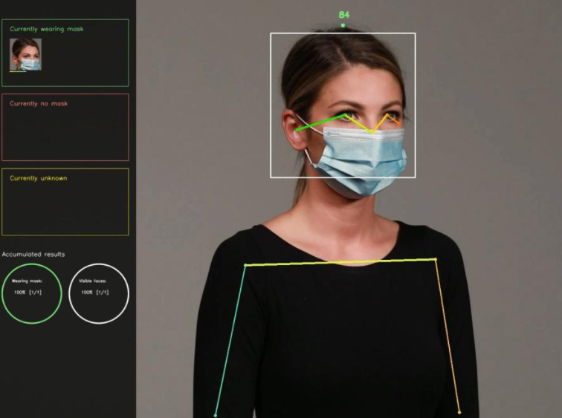
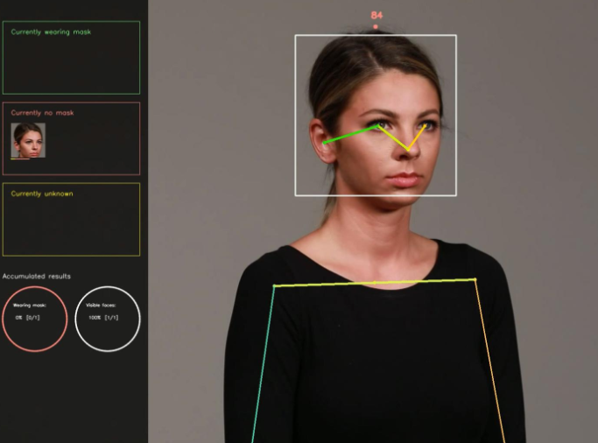
Face-mask recognition
Notes:
These pictures show us how the algorithm of LeewayHertz works . After the dectection of the face, the software classifies the face in categories. The differences cat are unknonw , no mask or mask . With this king of algo you can also have statistics that show how many people wear mask or not,

Slide 10
Other applications of facial recognition
National facial recognition system in Singapore
Facial recognition payment technology in Kazakhstan
Notes:
And another part of my research was to find cities where facial recognition is used to increase the quality of life. Singapore will integrate soon a digital identity system named SingPass. With this system every citizens could have acces to private and public gouvernement sevices through facial recognition. In Kazakhstan, in 2021 passengers of public transport will be able to use their faces to pay for a ticket using Facial recognition . This technology is named Face pay Technology.

Slide 11

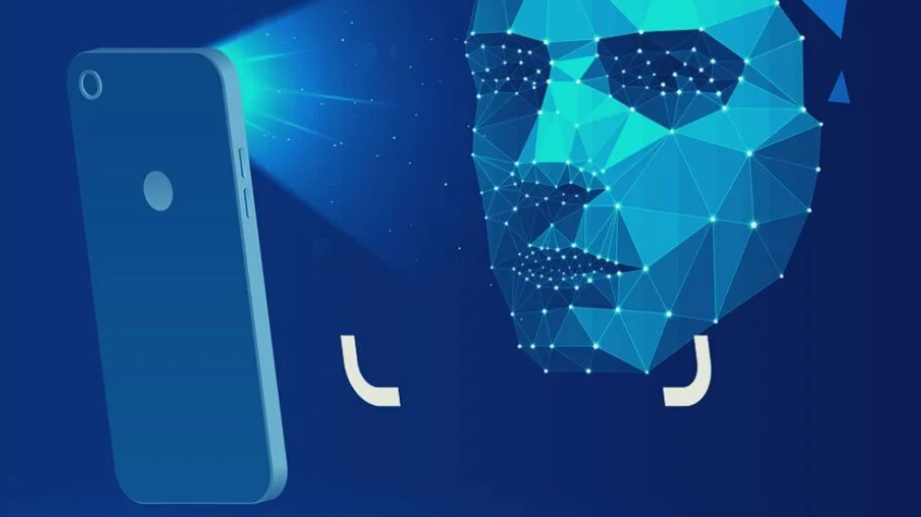




Thanks for listening

